Slide 1
Multiple Linear Regression

Slide 2
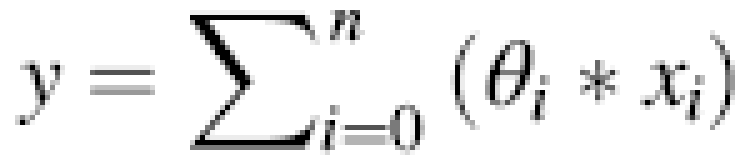
Multiple Linear Regression
Y= b₀ +b₁*x₁+b₂*x₂+…+b_{n}*x_{n}
_{OR}
We can also bring in a term x0, such that its value is always 1
This allows you to write the equation in a further compact form:
is equation also called a hypothesis function (or just hypothesis) and is represented by h0.
Now, the need is to find the appropriate values of coefficients θ.
Once that is done, it would be possible to predict y.
There are two popular methods for computing θ: Normal Equation Method and Gradient Descent Method.

Slide 3
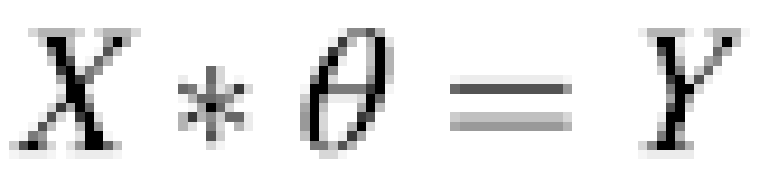
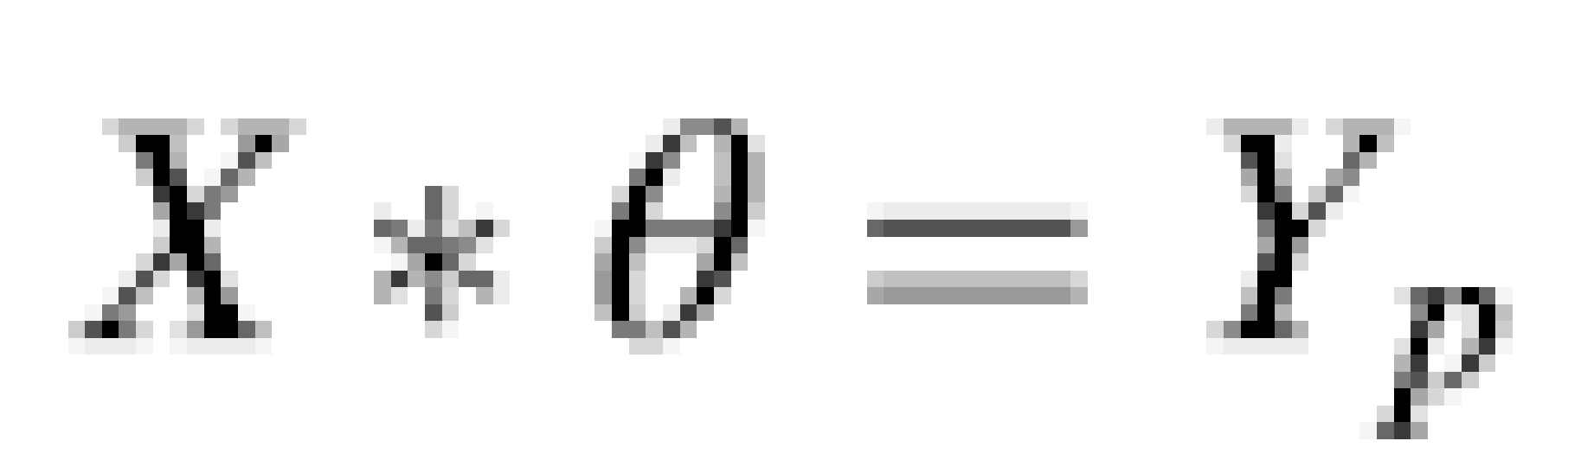
Normal Method
You can think of the hypothesis being expressed as a matrix equation
Where X is matrix of dimensions (m, n + 1), m rows (one row per data point), and n + 1 columns (first column with implicit feature value of 1 and then n columns – one per feature)
θ is a column matrix of dimension (n + 1, 1), having values θ0 through θn
Y is another column matrix of dimension (m, 1), having values Y1 through Ym, representing the observed values for the m data points
While you want the solution to above Eq. to be as accurate as possible, in reality, it might not be possible to find the value of θ such that the equation would be satisfied exactly for each of the m observations.
Hence, the attempt is to find θ such that X * θ is as close to Y as possible.

Slide 4
You need to find θ such that Yp is as close to Y as possible, i.e., (Y – Yp) should be as close to 0 as possible. And this should be evaluated on the basis of all the rows of data.
Sometimes, a value of θ which improves the error for a given row could deteriorate the error for another row.
So, you want to consider the total (or, average) errors across all the rows.
When you consider the errors for all the rows, large positive error for a row could potentially be cancelled by large negative values on another row.
To overcome this problem, you want to consider the square of an error, which is always positive, and hence, there is no chance of errors from different rows being cancelled by each other.
Since Y, Yp are both column matrixes, Y – Yp is also a column matrix, and squaring each number (to get rid of negative values) can be thought of as (Y- Yp)^{T}(Y- Yp) where (Y- Yp)^{T} is transpose of matrix (Y- Yp).
This is equivalent to squaring of each element of column matrix (Y - Yp).
So, now, the requirement is to minimize (Y- Yp)^{T}(Y- Yp)

Slide 5
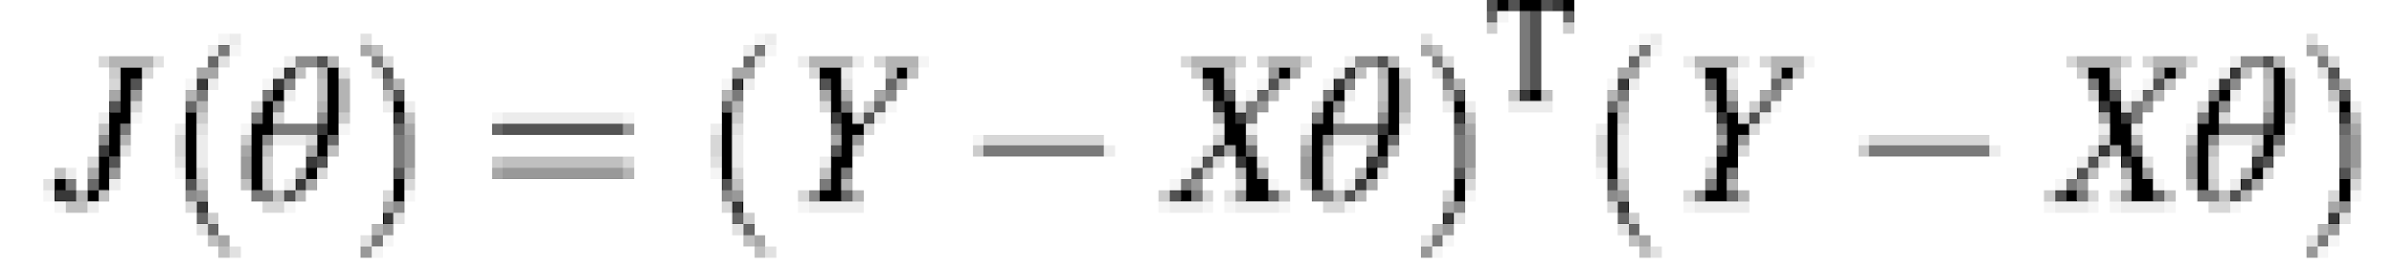
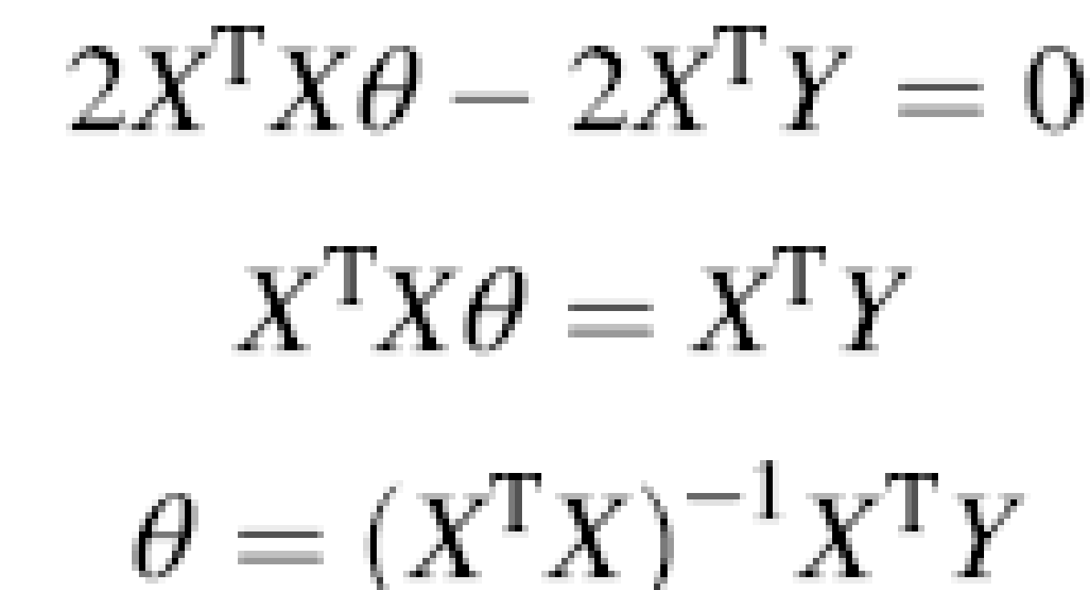
The term that you want to minimize is called cost function or the loss function and is often represented by J(θ).
Differential calculus says that for any curve, at its minimum value, the slope of the curve will be 0.
Using matrix differential calculus, the slope of the J(θ), i.e., taking a derivative with respect to θ, will be 2X^{T}Xθ- 2X^{T}Y
Equating this slope to 0, you will get
So, given matrices X and Y for a large number of sample set, it is possible to determine the value of column matrix θ that will provide you with a way to predict a new value of y for a new set of features

Slide 6
Disadvantage of Normal Equation Method
Normal Equation Method has one major disadvantage that needs matrix inversion (X^{T}X).
Not all matrices can be inverted, and even when invertible, very large matrices can take a long compute time to invert.
In such cases, we use another method called Gradient Descent.
A general rule of thumb could be, if you have the X^{T}X to be larger than 1000 x 1000 matrix, you may go with Gradient Descent method.
Some of the reasons for matrices not being invertible could be:
  Some of the features are directly related, and thus, some columns in X are redundant
    In that case we need to get rid of redundant columns.
  There are more variables than instances. This anyways means a non-unique solution.
    This should be fixed by having many more instances, compared to the number of features that you have in your model.

Slide 7
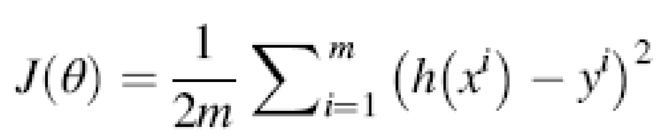
Gradient Descent Method
You know that predicted value y_{p} = h_{o} = θ₀ * x₀ + θ₁ * x₁ + . . . + θ_{n} * x_{n}, and the error for any given dataset is equal to y_{p} – y.
Since you have m data points, the total error over these m data points should be considered.
And that total error is given by:
where
h(x^{i}) represents the predicted value y_{p} for the ith dataset
h(x^{i}) y^{i} represents the error between the predicted value y_{p} and the actual observed value y for the ith dataset
m is the number of data points in the dataset (such as historical data used in modeling)
J(θ) is the total error term of the model for all the datasets

Slide 8
Gradient Descent Method
And the division by 2m is for getting the average.
Strictly speaking, you should be dividing by m for getting the average.
However, we will be using a scaling by an arbitrary constant anyways.
And so, you can divide (or, multiply) by any constant.
Division by 2 is for ease in some further mathematical formulation.

Slide 9
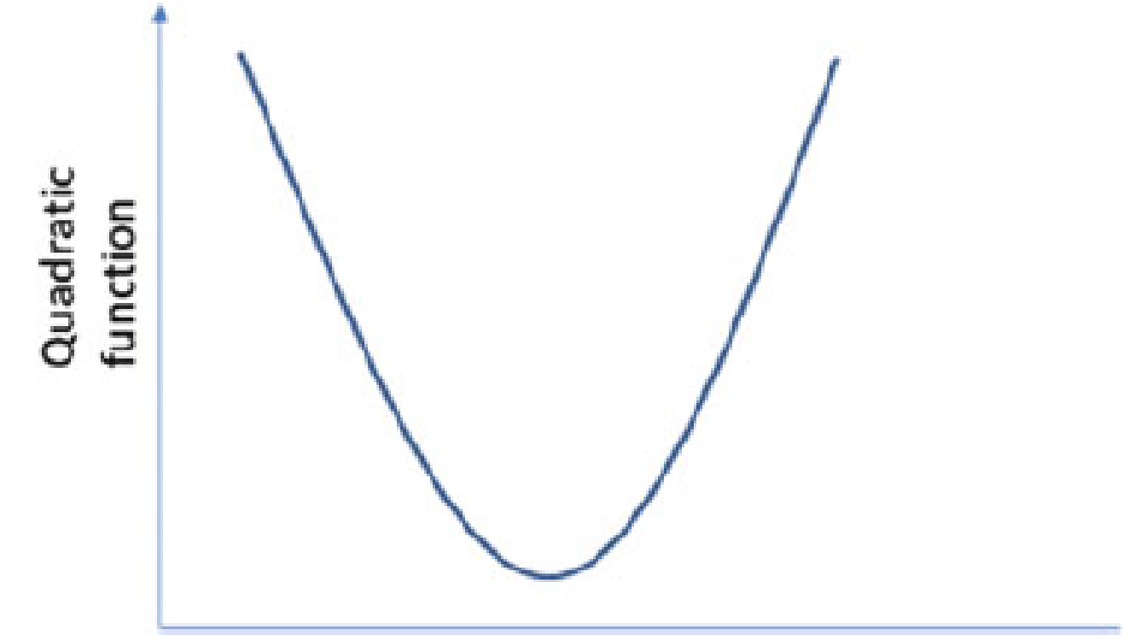
Since equation for the cost function is quadratic, its curve would look something like shown in Fig.
This shape of the quadratic equation gives you a few very interesting properties.
There is only one minimum value on this curve.
The further you are from the local minima, the higher is the absolute value of the slope.
The positive and negative value of the slope will also indicate whether you are to the right of the minima or to its left.

Slide 10
The name Gradient Descent comes because the solution exploits these three properties of the quadratic curve.
The solution will descend on this curve toward the minimum, using gradient (or, slope) direction and the value as a guidance.

Slide 11
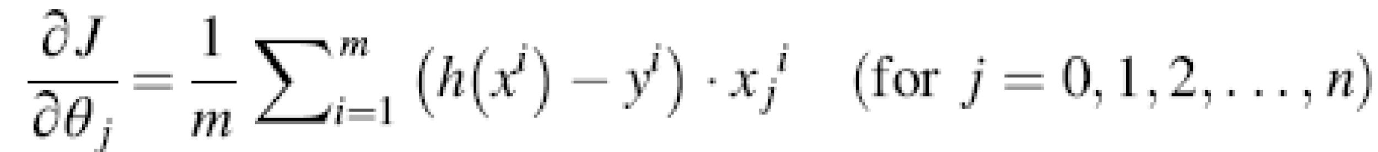
Determine the Slope at Any Given Point
the slope of J(θ) with respect to each of θj ( j = 0, 1, 2,. . ., n).
if for any θj, the slope is positive, reduce the value of θj, and if the slope is negative, increase the value of θj.

Slide 12
Initial Value
You can pick up any initial value for each of θj ( j = 0, 1, 2,. . ., n).
It just does not matter what value you choose.
Often, people start with a choice of 0 for each of θj ( j = 0, 1, 2,. . ., n).

Slide 13
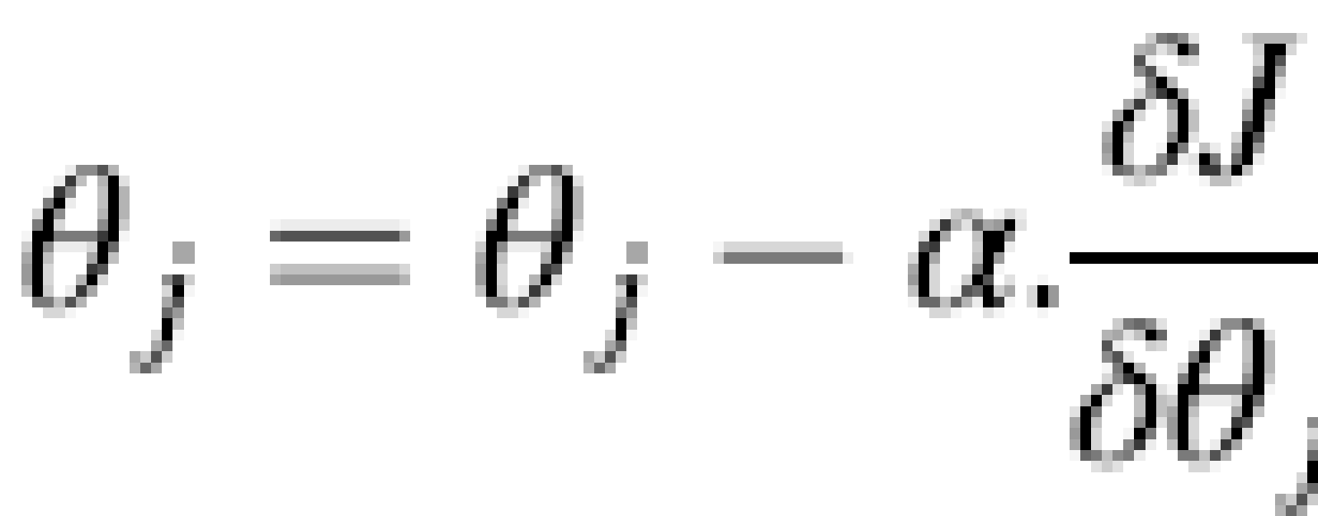
Correction
now, update each of these θj.
The way to apply the correction is:

Slide 14
Learning Rate
The slope (sign- direction) tells you whether to increase or decrease the θj.
However, by how much? That “how much” is controlled by α, also called learning rate
a smaller value of α will mean smaller steps, and hence it will take longer to reach the desired point.
On the other hand, a larger value of α would mean larger steps. While the obvious advantage is that it will reach toward the solution faster, there is always a risk that it might overshoot the solution
Thus, you need to choose a good value of α.
Unfortunately, there is no good algorithmic way of finding the best value of α.
You need to try various combinations and monitor if the solution continues to converge and how fast does it converge.
So, try values of α in the range of 0.001 through 1, with various values in between, say 0.003, 0.01, 0.03, 0.1, 0.3, etc.
Effectively, steps in multiple of ~3. If in doubt, choose a lower, rather than higher value.

Slide 15
Another interesting point is you would want to take larger steps, when you are further away from the solution, so that you don’t have to take too many steps.
And you would want to take smaller steps, when you are closer to the solution, so that you don’t overstep.
There is no need to change α for achieving this different step-size.
This effect can be achieved due to slope changing.
Given our cost function, the slope will be higher when you are further from the desired solution, and thus, you will be taking bigger steps.
And closer to the desired solution, the slope would be smaller, and hence, you will be taking smaller steps.

Slide 16
This concept of α is providing a scaling factor for applying the correction to computed slope.
Since there is anyways a final scaling applied to the slope, the initial arbitrary scaling of slope is not an issue, since an appropriate choice of α will nullify the arbitrarily scaled slope earlier.
This is the reason why we had added an additional factor of 2 in the denominator, which made the expression for slope easier.

Slide 17
Convergence
A solution is said to be converging when continued iterations of the computation bring the solution closer to desired value
How do you know you are done and don’t need to continue applying corrections any further?
How do you know the solution is even converging?
One good method is to keep monitoring the cost function J(θ).
With each iteration, J(θ) should be decreasing.
As long as J(θ) is decreasing, you know that you are descending on the cost curve, and hence, the solution is converging.
On the other hand, if J(θ) is increasing, or even oscillating, that means either something is wrong in our algorithm/coding or the choice of α is too high and should be reduced.
So, monitoring J(θ) can help you confirm that the solution is converging.

Slide 18
when to stop applying corrections
Now, you need to decide when to stop applying corrections and feel satisfied with the solution at hand.
When the change in J(θ) is very small, you know that you are close to the solution.
The cost function curve has shown that closer to the minima, the slope is very small, and hence, a very small change in J(θ) per iteration means you are close to the minimum.
Depending on how close to the minimum do you want to go, you can choose the appropriate criterion for stopping to apply further corrections.

Slide 19
Note
While determining the criterion for achieving closure, consider the value chosen for α.
Assume you have chosen a very small value of α.
That means the correction applied for each iteration would be very small, even if you are very far from the solution.
So, a very small change in J(θ) may satisfy the criterion for your convergence.
In reality, it is not that the solution has converged, just that your choice of α was so small that the iteration caused a very small step and hence, small improvement.

